Slide 1

Chapter 6
Talent and Giftedness

Slide 2



Slide 3
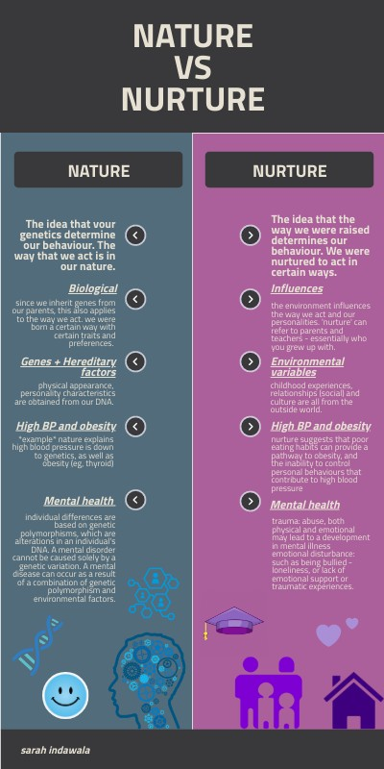

Nature vs Nurture and Talent/Giftedness

Slide 4
Why is it important to study talent and giftedness?
Helps us create environments where talent and giftedness can flourish
Witnessing excellence may lead to admiration and the urge for self-improvement
Ensures that we continue to advance as a society and community

Slide 5
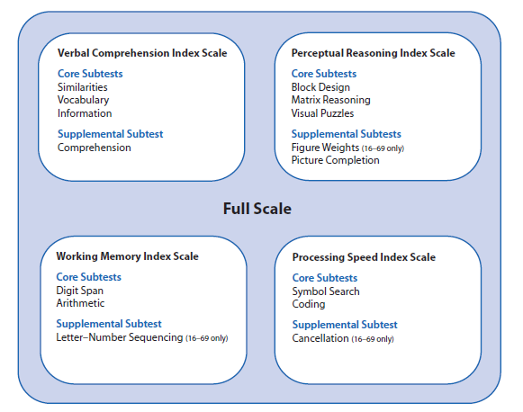
Identifying Talent & Giftedness
How do we operationally define these concepts?
  Subjective judgments (not sufficient for research)
  Standardized assessments
    Intelligence tests for intellectual giftedness
    Speed and agility tests in athletics
    Standardized cases or trial materials (e.g., sales at a company, or mock trial scenarios)
Weschler Intelligence Test

Slide 7
Three Different Views on the Nature and Nurture of Talent & Giftedness
Talent and giftedness are largely innate
  Goal is to identify talented and gifted individuals early and provide necessary challenges for full realization of gifts
Talent and giftedness are developed
  Identify the skills (e.g., persistence, flexible thinking) that allow talent and giftedness to flourish
Neither innate talent nor hard work is enough to truly excel in any area – need both
  Identify talents and giftedness early and provide opportunities to build on skills and talents

Slide 8
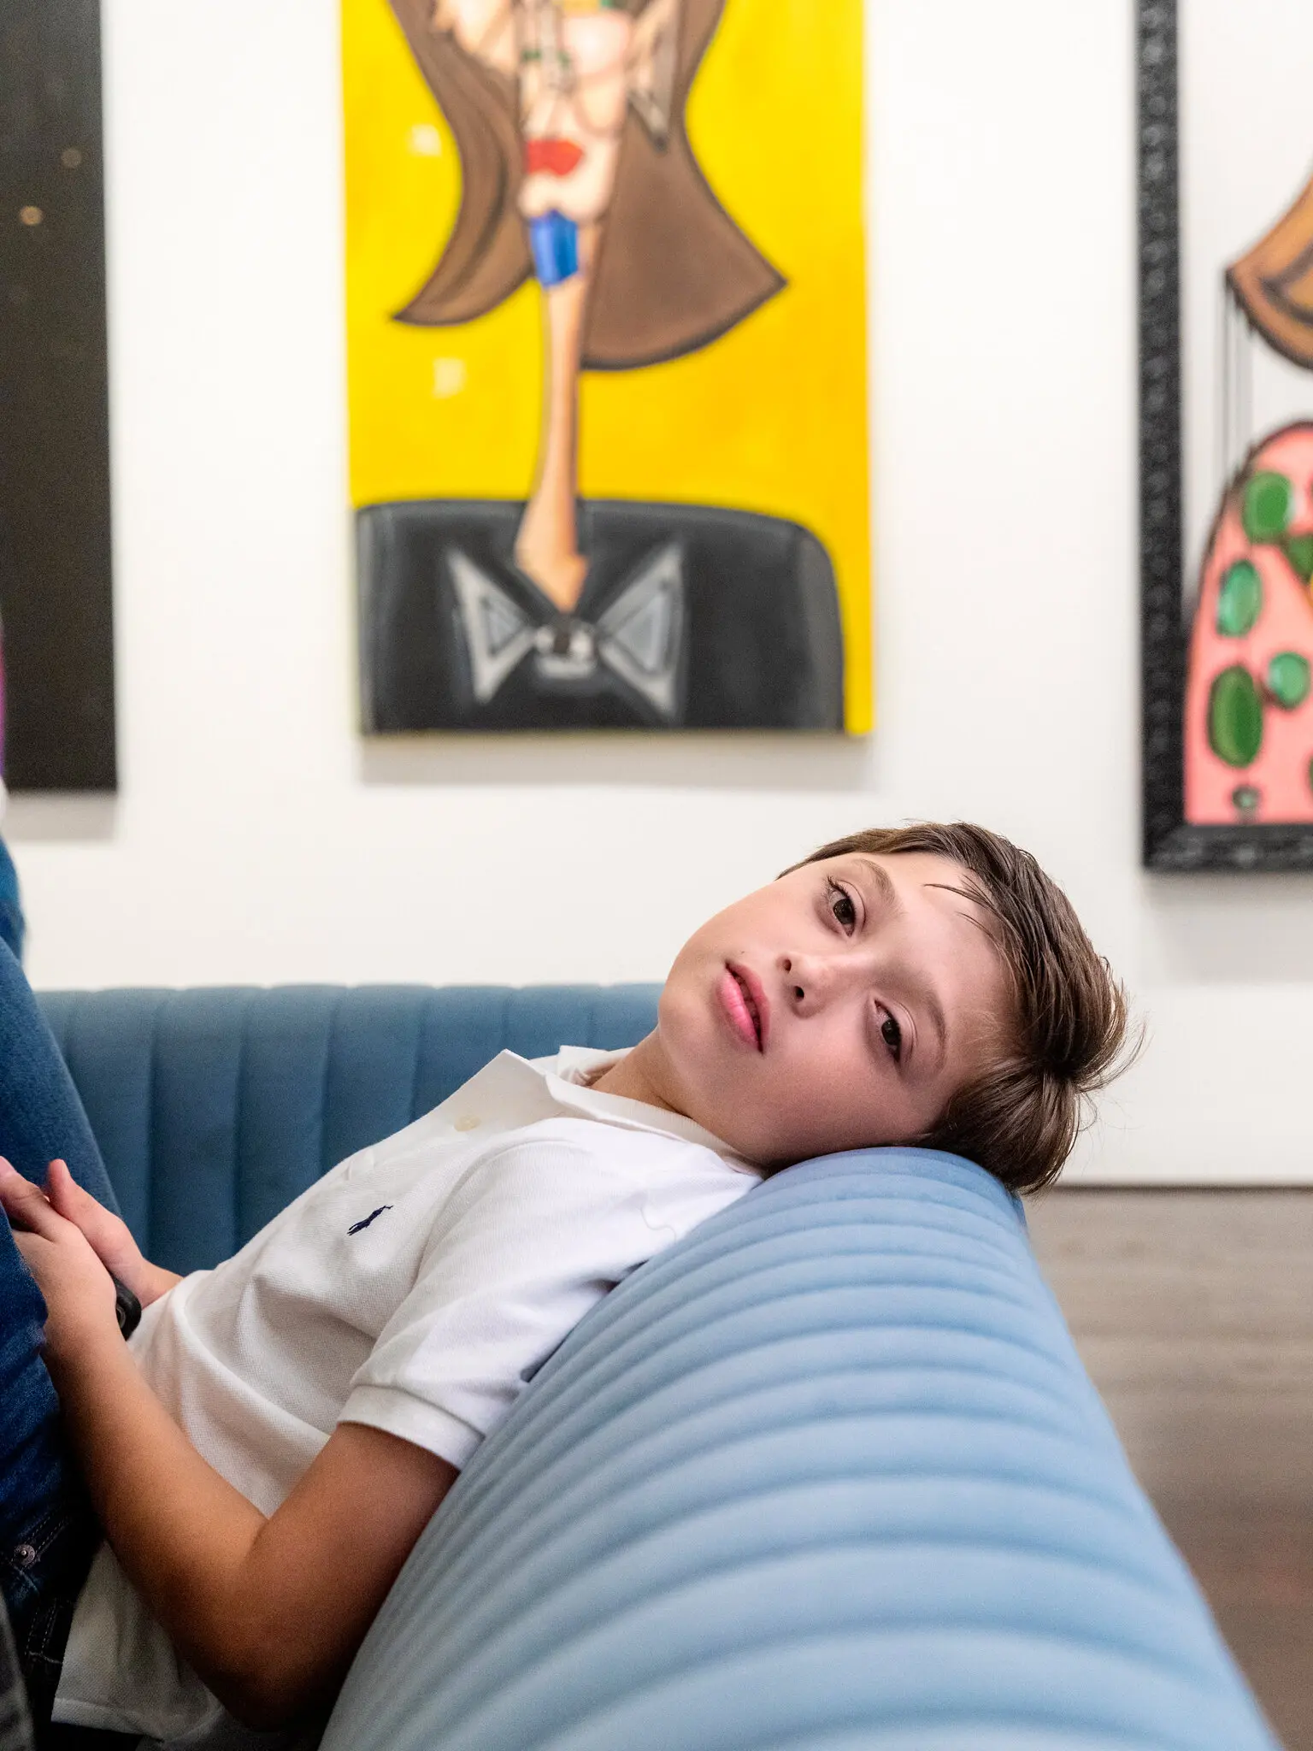
Andres Valencia
10 yrs old
“art prodigy”
“little Picaso”
https://www.nytimes.com/2022/09/26/style/andres-valencia-art-paintings.html

Slide 9
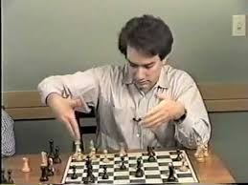
The Development of Talent/Giftedness…Consider this
Are we born with superior mental abilities?
Consider Grandmaster chess players
https://www.youtube.com/watch?v=rWuJqCwfjjc

Slide 10
Heritability of Extreme Intelligence
High Cognitive Abilities Consortium (11,000 identical and fraternal twin pairs)
Heritability estimate of high intelligence (top 15%) = 50%
Heritability estimate of intelligence (whole sample) = 55%
Swedish men joining military between 1968 – 2010
Identical and fraternal twins as well as non-twin brothers
Based on twin analyses, high intelligence (top 5%) heritability estimate = 44%

Slide 11
Biological Predictors of Athletic Giftedness
Twin study from 7 European countries (N = 37,051)
Heritability estimate for tendency to engage in athletics for leisure ranged from 48% to 71%
Muscle mass and explosive strength have high heritability estimates

Slide 12
Relative Age Effect
Relative age effect is the advantage of being born earlier in your age cohort
Older, more physically mature young people tend to be better athletes and students than their younger peers
Vincent & Glamser (2006) found RAE was more pronounced in male soccer players than female
May negatively impact younger players in early development
But those who continue in the sport may benefit later

Slide 13
Deliberate Practice
(Ericsson et al., 1993)
Performance and expertise tend to improve over time
Innate abilities cannot fully explain talent and giftedness
Argued that a particular type of training and preparedness is necessary for excellence
Activities relevant for deliberate practice:
Variability in objective performance outcomes
Person is motivated to work for the activity
Person wants to improve performance

Slide 14
Deliberate Practice: Factors that Facilitate Improved Performance
Immediate Feedback: Built in success and failure feedback
  Examples: shooting baskets, writing code, playing SCRABBLE
Personalized feedback from a teacher or expert
  Importance emphasized in later writings
  Expert is responsible for continuing to increase difficulty of practices
  Skills must improve to meet continued challenges

Slide 15
Important Study:
Ericsson et al., 1993
Prestigious music school in Germany; Study of violin students
Instructors asked to nominate:
“The Best”: Potential for international career as soloist
“The Good”: Quite good but not as good as “the best”
Third group drawn from music education department at same school – “teachers”
10 in each group
Interviewed
Completed daily reports of activities

Slide 16
Findings from Ericsson et al. (1993)
No differences in:
Age started playing (M = 8)
Age at decision to be a professional musician (M = 15)
Number of music teachers
Number of other instruments played
Time spent practicing alone: Best & Good > Teachers (ave 24.3 hrs/week vs 9.3 hrs/week)
Number of practice sessions: Best & Good > Teachers (3x more practice sessions)
Hours of practice per week before age 18: Best > Good & Teachers

Slide 17
Hours Practiced by Age 18

Slide 18

10,000 hours claim
Ericsson has said this claim is untrue and an inaccurate representation of his research
Excellence in some skills may take more than 10,000 hours, others less than 10,000

Slide 19
Are these differences really about deliberate practice?
Some have argued that innate ability increases engagement and practice
Others argue the effect sizes of deliberate practice are over-estimated (e.g., Macnamara et al., 2014; 2016), particularly:
  When practice assessed in real time (instead of retrospectively)
  At high levels of skill or expertise
  For certain/complicated activities (e.g., education, professional activities)
Ericsson and colleagues counter many of these studies are not based on deliberate practice

Slide 20
A note about practice…
Over-practice
Over-practice can be harmful
This is a recognized danger to what is known as overtraining
Excellence requires sensible balance of hard work and rest (those who achieve high levels of excellence tend to practice about 4hrs/day)

Slide 21
Deliberate Practice

Slide 22
4 Principles of Deliberate Practice
Work on areas in need of improvement
  Rather than doing things that they already do well, focus on things that are challenging
Give full concentration
  Remove distractions (e.g., noise, social media, or people)
Get feedback
  Notice what you did right, and what you could improve
Repeat until mastery
  Continue to work on those areas in need of improvement

Slide 23
Things to help keep motivated to engage in deliberate practice
Rethink failure
  Failure is a normal part of learning
Rethink frustration and confusion
  Remember that frustration and confusion are a natural part of practice
Rethink talent
  Read books, watch TV interviews, or listen to podcasts that focus on how musicians, athletes, or actors work on their craft to be successful
Share the experience
  Share your experiences of failure, frustration, practice, and success with friends and family and ask them to reflect on the value of practice. Perhaps ask how they have dealt with failure.

Slide 24

Journal Entry #14:
Deliberate Practice
Reflect on a behavior or skill where you have engaged in deliberate practice. How have you used the principles of deliberate practice or stayed motivated to engage in deliberate practice? Would you do anything differently in the future?

Slide 25
Longitudinal Study: Mathematically Precocious Youth (SMPY)
More than 5,000 7th and 8th graders recruited between 1972 – 1997
  Scored in top 3% of standardized achievement tests
  Invited to take the SAT
  Divided into:
    Cohort 1 – top 1 in 100
    Cohort 2 – top 1 in 200
    Cohort 3 – top 1 in 10,000
    Cohort 4 – top 3% on grade-level achievement test
Additional cohort of 1st or 2nd year graduate students in top-ranked STEM departments in the US

Slide 26
SMPY Enrollment Criteria

Slide 27
Major Findings of SMPY
Doctoral degree by age 33:
  Cohort 1: 25%
  Cohort 2: 30%
  Cohort 3: 50%
Compared to lowest 25% on the SAT-M, top 25% more likely to:
  Obtain a doctorate
  Obtain a STEM doctorate
  Earn more money
Findings challenge the threshold theory – that after a certain level of intelligence, more intelligence doesn’t bring added benefit

Slide 28
The Excellence Gap
Black, Latinx, and English-as-Second-Language (ESL) students are under-represented in gifted/talented and STEM programs at all levels
  BIPOC and ESL students tend to leave gifted and talented programs at higher rates than White students
Black, Indigenous, People of Color (BIPOC) students are under-represented in STEM majors in college
  Black and Latinx students equally likely to declare STEM majors but more likely to leave major/college than White students
  This continues into graduate programs and medical school

Slide 29
Initiatives to Address Excellence Gap
Move away from standardized tests for entry into gifted and talented programs
Instead:
Projects as initial entry into assessment
Accelerated, challenging curriculum to identify students
Scholastic mentorship and preparation programs
Reveal the “hidden curriculum”
High School to College prep programs
College to Graduate/Professional school programs

Slide 30

Passion
Intense interest and personal commitment to an activity regarded as central to one’s self
Dualistic model
  Harmonious passion
    Result of autonomous motivation
    Freely chosen
    “Fits” identity
    is engaged in joyously and effortlessly
    Flow is often experienced
  Obsessive passion

Slide 31
Passion
Dualistic model
  Harmonious passion
  Obsessive passion
    Results from feelings of being controlled
    Often involves rigid persistence
    May create conflicts within one’s identity and life, as well as feelings of anxiety and even shame.
    Examples: Gambling, Internet preoccupations

Slide 32

Passion
  Harmonious passion, Obsessive passion
    Harmonious passion has positive effects on health and well-being
    Harmonious passion in sports: greatest effects if it helps meet one’s needs for autonomy, competence, relatedness, and achievement

Slide 34

Grit (Angela Duckworth)
Duckworth’s definition
  Combination of passion and persistence
Key element responsible for higher achievement and success
Better predictor of academic performance than both IQ and SAT scores
Increases with age
Effortful persistence
  A meta-analysis by Credé, Tynan and Harms (2017) concluded that “the primary utility of the grit construct may lie in the perseverance facet.”

Slide 35


